Slide 1
Definition of rdbms
Stands for "Relational Database Management System." An RDBMS is a DBMS designed specifically for relational databases. Therefore, RDBMSes are a subset of DBMSes.

Slide 2
Fonction of rdbms
data dictionary management, data storage management, data transformation and presentation, security management, multiuser access control, backup and recovery management, data integrity management, database access languages and application programming interfaces, database communication interfaces, and transaction management.

Slide 3
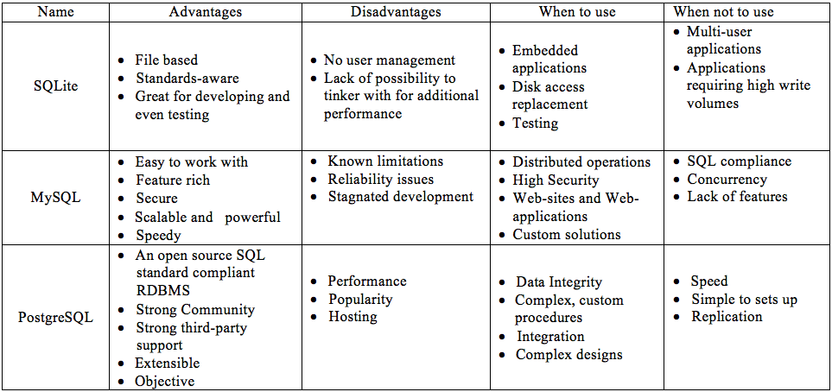
Diference between rdbms

